Slide 1

Objectives
In this session, you will learn to:
  Create a chart
  Modify charts
  Format charts
  Create a PivotTable report
  Analyze data using PivotCharts
  Insert and modify pictures and ClipArt
  Draw and modify shapes
  Illustrate workflow using SmartArt graphics
Notes:
Discuss the session objectives with the students.

Slide 2
Create a Chart
A chart:
  Is a visual representation of data from a worksheet or Excel table.
  Can include:
    Chart title
    Legend
    Scale or values on the vertical axis
    Category on the horizontal axis
  Can be embedded as a graphic object on a worksheet page.
  Can appear on a dedicated chart sheet that contains only the chart and associated chart tools and commands.
Notes:
As an example, show the following file to the students and ask them to analyze Sheet 1 of the file.
TIRM\SOLUTIONS\Level 2\Scenarios\Food Habits.xslx
After 15 minutes of discussion, show the second sheet, Chart 1. Discuss the solution with the students. Ask the students to figure out the difference between the two sheets, Sheet 1 and Chart 1.

Slide 3
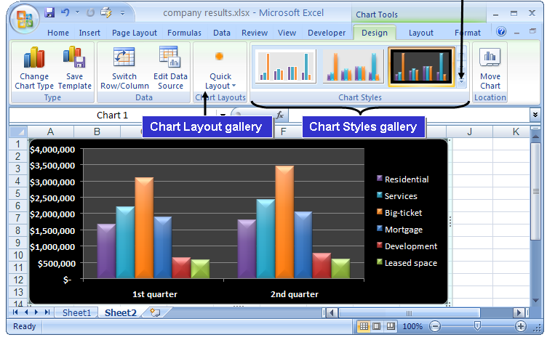
Create a Chart (Contd.)
The following figure shows a chart.
More Button
Notes:
Use the following scenario to discuss the chart given in the slide:
Residential
Services
Big-ticket
Mortgage
Development
Leased space
The Sales department of an organization keeps track of the quarterly profit of the company. In order to show the profit percentage of the company, the Sales department compares the last year’s and the current year’s earnings from these sectors. Thus, for a better understanding, the Sales department creates a chart to present the data.
For example, as shown in the figure, the company earned $3,000,000 from the Big-ticket sector in the first quarter. But in the second quarter, the amount has gone up to $3,500,000, with a profit of $500,000.

Slide 4



Create a Chart (Contd.)
Types of Charts:
Column charts are used to compare values across categories.
Line charts are used to display trends over time.
Pie charts are used to display the contribution of each value to a total.
Notes:
Use the slide to discuss about the different chart types that can be used to create the best representation of a particular data.
Then give a brief overview of the chart insertion methods given in Page 65.
You can also use the following links that discusses the different types of charts that serve different purposes.
http://spreadsheets.about.com/od/c/g/chart_def.htm and
http://office.microsoft.com/en-us/help/HA012337371033.aspx

Slide 5



Create a Chart (Contd.)
Bar charts are used for comparing multiple values.
Area charts are used to emphasize differences between several sets of data over a period of time.
Scatter charts are used to compare pairs of values.
Notes:
You can also use the following link that provides the step-by-step Excel chart tutorial, starting from entering data into the spreadsheet.
http://spreadsheets.about.com/od/excel101/ss/enter_data.htm

Slide 6
Demo: Creating Charts
Scenario:
  You have been asked to present your company’s financial sales report at a board meeting. Your manager has requested that you present the data in a way that the board members will be able to clearly see the relationships between the different sections of the data. You have determined that a bar chart will be used to compare the monthly sales of Books versus CDs and tapes. You would also like to show board members that the sales of fiction has steadily increased during the past year and you will use a line chart to show this trend. To show how the total budget amount has been allocated between departments, you have decided to use a pie chart.
Notes:
Discuss the scenario of Activity 3-1 of Lesson 3 in the Student Guide with the students.
You can access the data file for this activity from the following path in the TIRM CD:
TIRM\DATAFILES FOR FACULTY\LEVEL 2\Session_02\Lesson 3\Charts.xlsx

Slide 7
Demo: Creating Charts (Contd.)
Solution:
  To solve the preceding scenario, you need to perform the following tasks:
    Create a 3-D bar chart from the data to compare the monthly sales of products.
    Create a Line chart to display the trend in fiction sales.
    Create a 3-D Pie chart to display the 2008 budget for each department.
Notes:
Discuss the solution with the students. To demonstrate the solution, access the file provided at the following path in the TIRM CD:
TIRM\SOLUTIONS\Level 2\Demos\Lesson 3\My Charts.xlsx

Slide 8
Modify Charts
You can format each chart item to appear exactly as you need to meet your business requirements.
Chart elements:
  Chart title
  Category (X) axis title
  Value (Y) axis title
  Axes
  Gridlines
  Legend
  Data labels
  Data table
Notes:
You can use the following link that provides a demo on creating a combination of Chart in Excel 2007. This link also provides examples for the same.
http://examples.oreilly.com/9780596527594/Excel/Chapter18/Combination-Chart.html

Slide 9
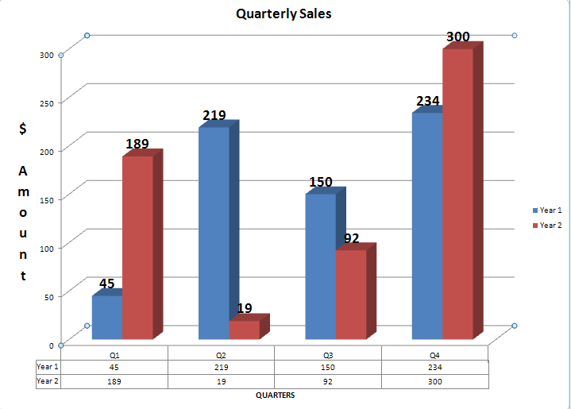
Modify Charts (Contd.)
The following figure shows the chart elements.
Vertical Axis
Title
Data Labels
Legend
Vertical Axis Title
Horizontal Axis
Gridlines
Data Table
Horizontal Axis Title
Notes:
Later, discuss the Chart Tools contextual tabs given in Page 69. These tabs are used to manipulate the appearance and layout of charts.

Slide 10
Demo: Changing a Chart Type
Scenario:
  After reviewing the bar chart, you feel that the data would be better represented in a column chart. You have also decided to increase the size of the line chart.
Notes:
Discuss the scenario of Activity 3-2 of Lesson 3 in the Student Guide with the students.
You can access the data file for this activity from the following path in the TIRM CD:
TIRM\DATAFILES FOR FACULTY\LEVEL 2\Session_02\Lesson 3\My Charts.xlsx

Slide 11
Demo: Changing a Chart Type (Contd.)
Solution:
  To solve the preceding scenario, you need to perform the following tasks:
    Change the bar chart to a 3-D Clustered Column chart.
    Increase the size of the line chart by approximately 1 inch.
Notes:
Discuss the solution with the students. To demonstrate the solution, access the file provided at the following path in the TIRM CD:
TIRM\SOLUTIONS\Level 2\Demos\Lesson 3\My Charts.xlsx
You tell the students that to use regular text formatting to format the text in chart elements, they can right-click or select the text, and then click the formatting options that they want on the Mini toolbar. They can also use the formatting buttons on the Ribbon (Home tab, Font group of Microsoft Office user interface.

Slide 12
Demo: Modifying a Chart
Scenario:
  You have just created charts for the different sets of data. You have decided to present the pie chart in a separate chart sheet and you would like to modify the chart to include percentages to show the board members how the budget has been divided between the departments. To ensure that the board members can see what the chart represents, you have decided to add a chart title as well as vertical and horizontal axis titles.
Notes:
Discuss the scenario of Activity 3-3 of Lesson 3 in the Student Guide with the students.
You can access the data file for this activity from the following path in the TIRM CD:
TIRM\DATAFILES FOR FACULTY\LEVEL 2\Session_02\Lesson 3\My Charts.xlsx

Slide 13
Demo: Modifying a Chart (Contd.)
Solution:
  To solve the preceding scenario, you need to perform the following tasks:
    Move the pie chart to a chart sheet and name the sheet 2008 Budget.
    Modify the pie chart to display each department’s percentage of the total budget for 2008.
    Add the chart title Sales Data to the 3-D column chart.
    On the 3–D column chart, add a horizontal and vertical axis title.
Notes:
Discuss the solution with the students. To demonstrate the solution, access the file provided at the following path in the TIRM CD:
TIRM\SOLUTIONS\Level 2\Demos\Lesson 3\My Charts.xlsx

Slide 14
Format Charts
There are many styles and layouts to choose from to format the chart:
  Change the appearance of the chart elements by using options on the Chart Tools Format contextual tab.
  Implement a standard set of chart elements by applying one of the pre-defined chart layouts.
  Customize the appearance of individual chart elements by using the options on the Chart Tools Layout contextual tab.
Notes:
You can use the following link that presents good information about Excel 2007 Formatting options. http://spreadsheets.about.com/od/excelformatting/a/format_hub.htm

Slide 15
Demo: Formatting a Chart
Scenario:
  You have created a line chart to represent the sales trend of fiction book sales. You would like to format the chart to enhance its presentability by having it reflect the same color style as the table. You would also like to exaggerate the horizontal axis of the chart.
Notes:
Discuss the scenario of Activity 3-4 of Lesson 3 in the Student Guide with the students.
You can access the data file for this activity from the following path in the TIRM CD:
TIRM\DATAFILES FOR FACULTY\LEVEL 2\Session_02\Lesson 3\Charts.xlsx

Slide 16
Demo: Formatting a Chart (Contd.)
Solution:
  To solve the preceding scenario, you need to perform the following tasks:
    Apply a chart style to the line chart.
    Apply a chart layout.
    Format the border of the chart.
    Format the horizontal axis.
Notes:
Discuss the solution with the students. To demonstrate the solution, access the file provided at the following path in the TIRM CD:
TIRM\SOLUTIONS\Level 2\Demos\Lesson 3\My Charts.xlsx

Slide 17
Create a PivotTable Report
PivotTables:
  A PivotTable report is an interactive worksheet table used to summarize and analyze large amounts of worksheet data quickly.
  You create a PivotTable report from source data in an Excel workbook or from an external data source.
  There are four types of PivotTable fields:
    Page
    Row
    Column
    Data fields
Notes:
Use the slide to discuss about a PivotTable and its types. A PivotTable can quickly combine and compare data to perform analysis on large amounts of data.
Discuss the Food_Habits scenario as discussed earlier in Slide 2 of this session. Now the comparison has to be made for the past four years of data. Tell the students that since the data to be used is in such a large amount, therefore, the PivotTables are used instead of the Charts.
Discuss the solution with the students. To demonstrate the solution, access the file provided at the following path in the TIRM CD:
TIRM\SOLUTIONS\Level 2\SCENARIO\PivotTable.xlsx
You can also tell the student that PivotTables allow rapid, dynamic, flexible data analysis. Pivot charts add to the flexibility of pivot tables, allowing the same rapid analysis of displayed data, while sacrificing substantial flexibility of normal Excel charts.
You can use the following link that provides a demo on building a PivotTable in Excel 2007. This link also provides some examples where PivotTable is used.
http://examples.oreilly.com/9780596527594/Excel/Chapter21/Pivot_Tables.html
Additional Input:
Live Microsoft Dynamics data can be delivered in refreshable Excel spreadsheets, such as PivotTables and Pivot charts, to ensure the entire organization is working with consistent, current, and accurate information. Microsoft Office SharePoint Server 2007 allows the users to share and access their Excel spreadsheets via a Web connection and is supported through automated exports directly from within the context of Microsoft Dynamics. Microsoft Dynamics forms, data, and information can be exported to Microsoft Excel from the List Pages and Task Page of Microsoft Dynamics.
By accessing Microsoft CRM information in Excel, the user has the ability to visually understand sales information, discover trends and drill into exceptions. For example, the user can understand and visualize the opportunity pipeline of Microsoft CRM using Microsoft CRM with Excel.

Slide 18
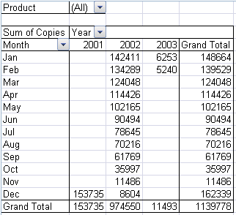
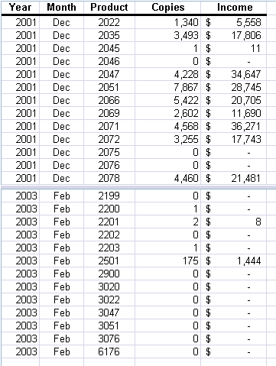
Create a PivotTable Report (Contd.)
The following figures show the four types of PivotTable fields.
Page Fields
Column Fields
Row Fields
Data Fields
Source Data
Notes:
The figures in the above slide consist of the source data from which PivotTable report is generated. The PivotTable report consists of the following four types of PivotTable fields:
Page field
Row field
Column field
Data field
You can also use the following link for having an overview of PivotTable reports and PivotChart reports.
http://office.microsoft.com/en-us/excel/HP101773841033.aspx#About%20PivotTable%20reports

Slide 19
Create a PivotTable Report (Contd.)
The PivotTable Field List pane:
  Appears when you select a PivotTable report.
  Includes Drop Zones into which you can drag and drop fields.
The Value Field Settings dialog box:
  Is used to display or hide subtotals for individual column and row fields.
  Is used to display or hide column and row grand totals for the entire report.
  Is used to calculate the subtotals and grand totals with or without filtered items.
Notes:
Discuss the PivotTable functions given in Page 83. These functions help to create a formula to work with PivotTable data.
You can use the following link that beautifully demonstrates the use of PivotTable report to analyze product sales.
http://office.microsoft.com/home/video.aspx?assetid=ES102390221033&width=884&height=540&startindex=0&CTT=11&Origin=HA102384511033

Slide 20
Demo: Creating a PivotTable
Scenario:
  You have a large volume of information about products that have shipped in the past several months in the Shipping workbook. Your manager has also asked you to print a list of products that have not shipped that were sold by the salesperson Anne Dodsworth. Your manager has requested another report to review the average price of the products Anne shipped the first week in January by company. Since you are confident that your manager will have a similar request in the future, you have decided to create a PivtotTable report to easily extract the information without constantly having to rearrange the data by sorting and re-creating formulas. You have decided to first review Anne’s data using the Sort tool before creating the report.
Notes:
Discuss the scenario of Activity 4-1 of Lesson 4 in the Student Guide with the students.
You can access the data file for this activity from the following path in the TIRM CD:
TIRM\DATAFILES FOR FACULTY\LEVEL 2\Session_02\Lesson 4\Shipping.xlsx

Slide 21
Demo: Creating a PivotTable (Contd.)
Solution:
  To solve the preceding scenario, you need to perform the following tasks:
    To locate products that have not shipped for Anne Dodsworth sort the worksheet by Salesperson and Shipped Date in ascending order.
    Create a PivotTable report to extract products sold by salesperson and by shipped date.
    Modify the Values field settings to calculate the average Extended Price, replace the column label in the PivotTable report to Average Amount Sold, and change the number format to Currency.
    Create a filter to group the PivotTable by Salesperson and then display products that Anne Dodsworth sold.
    Display products that Anne Dodsworth shipped the first week in January.
Notes:
Discuss the solution with the students. To demonstrate the solution, access the file provided at the following path in the TIRM CD:
TIRM\SOLUTIONS\Level 2\Demos\Lesson 4\My Shipping.xlsx

Slide 22
Demo: Creating a PivotTable (Contd.)
    In the PivotTable report, display which company the products are shipping to.
    Include average subtotals by company and format the PivotTable report.

Slide 23
Analyze Data Using PivotCharts
Graphical representations of data make data analysis easy.
PivotChart reports help facilitate data analysis by graphically representing data from PivotTable reports.
A PivotChart report is an interactive chart that graphically represents the data in a PivotTable report.
Notes:
Students have learned to create PivotTables to analyze the data. Now, they will learn to analyze the data using PivotChart. PivotChart reports help to facilitate data analysis by graphically representing data from PivotTable reports. These PivotTable reports and PivotCharts are used in Microsoft SharePoint Services for data analysis.
You can use the following link that provides an overview of PivotTable reports and PivotChart reports.
http://office.microsoft.com/en-us/excel/HP101773841033.aspx#About%20PivotTable%20reports

Slide 24
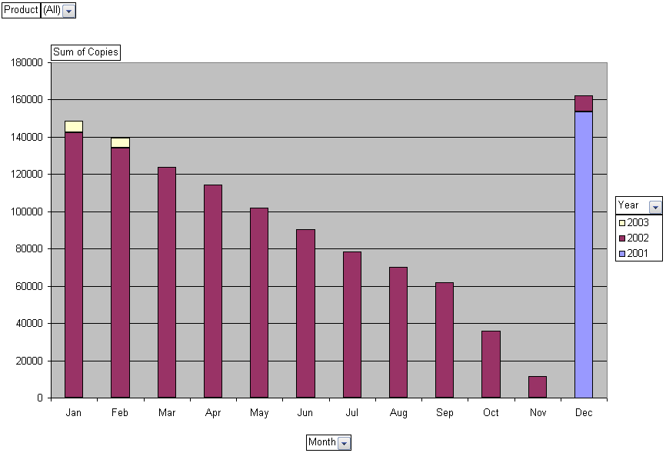
Analyze Data Using PivotCharts (Contd.)
The following figures show an existing PivotTable report and associated PivotChart.
Notes:
The figures in the above slide show a PivotChart generated from a PivotTable report.
You can use the following link that compares PivotTable report and a PivotChart report. In addition, this link also the difference between PivotChart and standard chart.
http://office.microsoft.com/en-us/excel/HP101773841033.aspx#About%20PivotTable%20reports

Slide 25
Demo: Creating a PivotChart
Scenario:
  Your sales managers has asked you to create a column chart, based on the data that is in the Invoices sheet, to show the sales people how they have been doing with their sales to Germany. This is a meeting that is held weekly, and the next week will be presentation on sales to France. You have decided to create a PivotChart to have the flexibility to switch the chart by country.
Notes:
Discuss the scenario of Activity 4-2 of Lesson 4 in the Student Guide with the students.
You can access the data file for this activity from the following path in the TIRM CD:
TIRM\DATAFILES FOR FACULTY\LEVEL 2\Session_02\Lesson 4\My Shipping.xlsx

Slide 26
Demo: Creating a PivotChart (Contd.)
Solution:
  To solve the preceding scenario, you need to perform the following tasks:
    Create a PivotChart.
    Create a PivotChart report filter that will filter the chart by product and/or country, and then filter the chart to display quantity amounts for Germany by sales person.
    Format the PivotChart.
    Change the Chart Title to Germany and remove the Legend.
Notes:
Discuss the solution with the students. To demonstrate the solution, access the file provided at the following path in the TIRM CD:
TIRM\SOLUTIONS\Level 2\Demos\Lesson 4\My Shipping.xlsx
Additional Input:
You can use the following link to know to procedure to delete a PivotTable report or a PivotChart report.
http://office.microsoft.com/en-us/excel/HP100898931033.aspx#Delete%20a%20PivotTable%20report

Slide 27
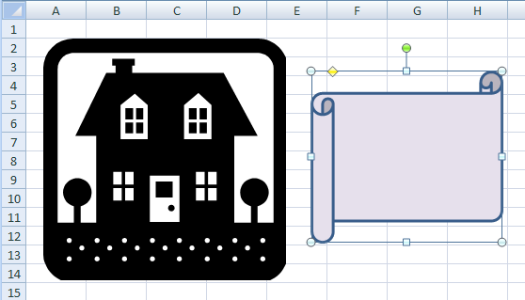
Insert and Modify Pictures and ClipArt
A graphic object is a visual element that can be inserted into a worksheet.
The following figure shows a graphic object.
Adjustment Handle
Rotate Handle
Selection Handles
Graphic Object
(Not Selected)
Graphic Object
(Selected)

Slide 28
Demo: Inserting and Modifying a Picture in a Worksheet
Scenario:
  You have been asked to improve the look of your spreadsheet reports by using graphics to create a logo. Since you have never done this before, you have created a workbook to experiment with the different types of graphics that could be used for a logo.
Notes:
Discuss the scenario of Activity 5-1 of Lesson 5 in the Student Guide with the students.
You can access the data file for this activity from the following path in the TIRM CD:
TIRM\DATAFILES FOR FACULTY\LEVEL 2\Session_03\Lesson 5\Graphics.xlsx

Slide 29
Demo: Inserting and Modifying a Picture in a Worksheet (Contd.)
Solution:
  To solve the preceding scenario, you need to perform the following tasks:
    Insert the globe graphic onto the worksheet Globe.
    Apply Picture Style 4 to the graphic.
    Resize the picture so that it is 1.5 inches wide and 1.5 inches tall.
    Apply the Sun picture shape to the globe graphic.
    Apply a blue 1 1/2 pt picture border.
    Apply a 3–D preset picture effect.
Notes:
Discuss the solution with the students. To demonstrate the solution, access the file provided at the following path in the TIRM CD:
TIRM\SOLUTIONS\Level 2\Demos\Lesson 5\My Graphics.xlsx

Slide 30
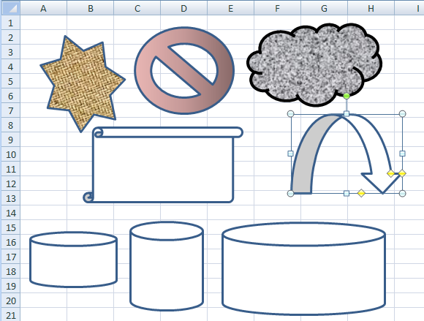
Draw and Modify Shapes
Shapes are simple geometric objects that you can draw and modify as needed to enhance your worksheets.
The following figure shows the shapes.
Formatted
Shapes
Selected
Shape
Handles
Resized Shapes
Notes:
The lines and shapes help to add emphasis to a particular area of a worksheet. They can create custom graphics easily by using Excel’s library of lines and shapes.

Slide 31
Draw and Modify Shapes (Contd.)
The various types of shapes include:
  Lines, arrows and connectors
  Rectangles and other geometric shapes
  Block-style arrows
  Mathematical symbols for equations
  Flowchart elements
  Stars and banners
  Callouts in various forms

Slide 32
Demo: Drawing and Modifying Shapes
Scenario:
  You have been trying to come up with a simple diagram to illustrate some ideas at a meeting and would like to augment the words you have chosen with graphics. Since you have never done this before, you will begin by inserting a graphic object onto a practice worksheet and then formatting the graphic so that the text displays through the graphic. You have also decided to include an arrow that will point to the next graphic.
Notes:
Discuss the scenario of Activity 5-2 of Lesson 5 in the Student Guide with the students.
You can access the data file for this activity from the following path in the TIRM CD:
TIRM\DATAFILES FOR FACULTY\LEVEL 2\Session_03\Lesson 5\My Graphics.xlsx

Slide 33
Demo: Drawing and Modifying Shapes (Contd.)
Solution:
  To solve the preceding scenario, you need to perform the following tasks:
    On the Shape Drawing worksheet, insert a rectangular shape over the text in cell B4.
    Change the transparency of the rectangle to 75 percent.
    Draw an arrow shape whose positioning handles trace the range C5:C7.
    Rotate the Down Arrow shape counter-clockwise approximately 45 degrees to line its head up so that it points to Larger Market Share.
Notes:
Discuss the solution with the students. To demonstrate the solution, access the file provided at the following path in the TIRM CD:
TIRM\SOLUTIONS\Level 2\Demos\Lesson 5\My Graphics.xlsx

Slide 34
Illustrate Workflow Using SmartArt Graphics
A SmartArt graphic:
  Is a custom-made visual representation of the relationships between data, events, or ideas.
  Combines graphic objects with text and connector symbols to create complex custom illustrations.
Notes:
SmartArt graphics are used to create a comprehensive workflow diagram that helps to present a complicated workflow process.

Slide 35
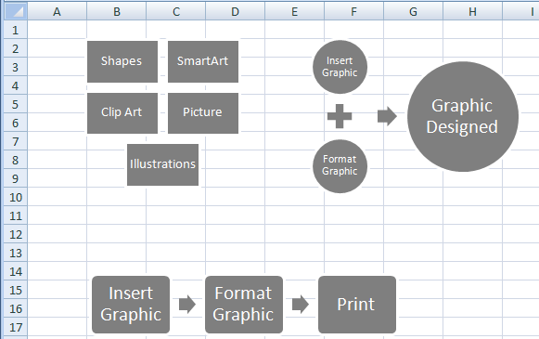
Illustrate Workflow Using SmartArt Graphics (Contd.)
The following figure shows SmartArt layouts.
Relationship
List
Process
Notes:
The SmartArt gallery, in the Illustrations group on the Insert tab, displays SmartArt layouts in seven categories. Refer to page 110 to list all the seven categories. Each category contains a variety of layouts for showing the appropriate type of relationship, sequence, or hierarchy between the components of the SmartArt object.
The figure given in the above slide shows three categories of SmartArt layouts:
List
Process
Relationship

Slide 36
Demo: Inserting a SmartArt Graphic
Scenario:
  You have an upcoming sales meeting where the intention is to motivate the sales people. You have decided to create a colorful process diagram that depicts the process steps for a successful salesperson.
Notes:
Discuss the scenario of Activity 5-3 of Lesson 5 in the Student Guide with the students.
You can access the data file for this activity from the following path in the TIRM CD:
TIRM\DATAFILES FOR FACULTY\LEVEL 2\Session_03\Lesson 5\My Graphics.xlsx

Slide 37
Demo: Inserting a SmartArt Graphic (Contd.)
Solution:
  To solve the preceding scert graphic.
    Enter the captions for the process steps.
    Add a new “Teamwork” step between process steps 2 and 3.
    Change the colors of the four process steps.
    Reposition the process steps into a zigzag configuration.
    Apply the 3-D Inset SmartArt style to the SmartArt graphic.
    Apply a Glow effect to the SmartArt graphic.
Notes:
Discuss the solution with the students. To demonstrate the solution, access the file provided at the following path in the TIRM CD:
TIRM\SOLUTIONS\Level 2\Demos\Lesson 5\My Graphics.xlsx

Slide 38
Summary
In this session, you learned that:
  A chart enables you to observe a large amount of data and draw relevant conclusions quickly.
  PivotTables and PivotCharts enable you to interactively analyze and manipulate large amounts of data.
  PivotTable reports help you quickly combine and compare data in large worksheets.
  A PivotChart report is an interactive chart that graphically represents the data in a PivotTable report.
  A graphic object is a visual element that can be inserted into a worksheet.
  A SmartArt graphic combines graphic objects with text and connector symbols to create complex custom illustrations.
  Lines and shapes can help to add emphasis or draw attention to a particular area of a worksheet.
Notes:
Use the Summary slide to summarize the session.

